Slide 1
BARBERSHOP BOOKING WEB-BASED APPLICATION
This presentation showcases some of the screenshots from the design User Interface

Slide 2
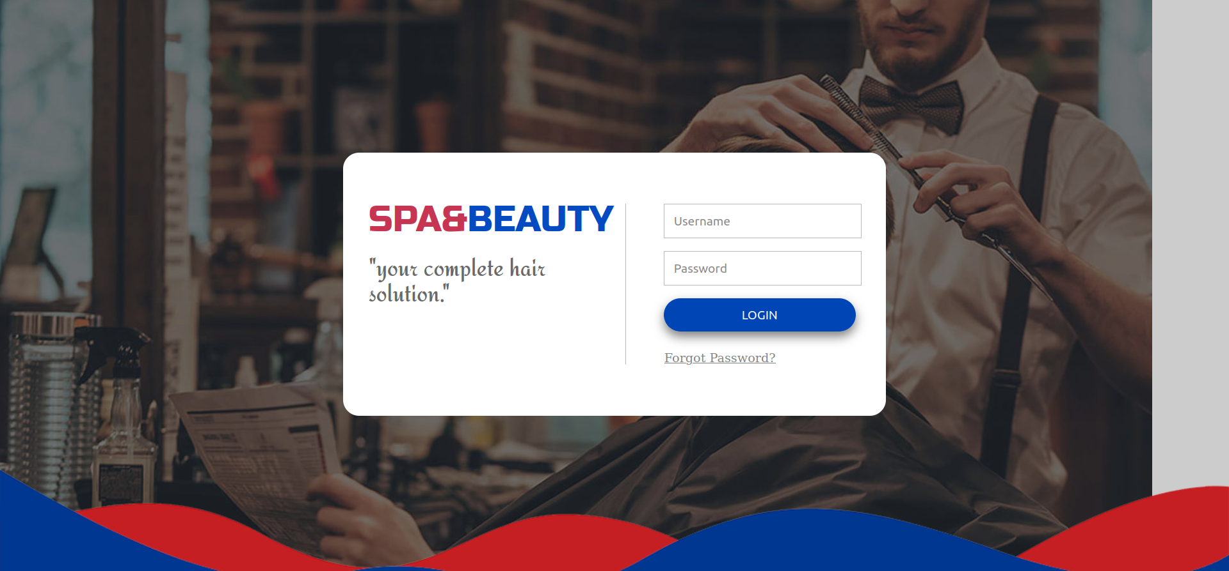
The Login form page

Slide 3
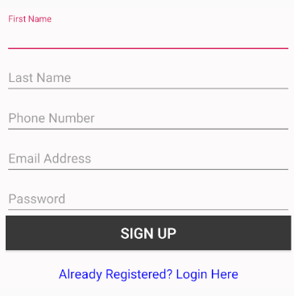
Registration Form Page

Slide 4
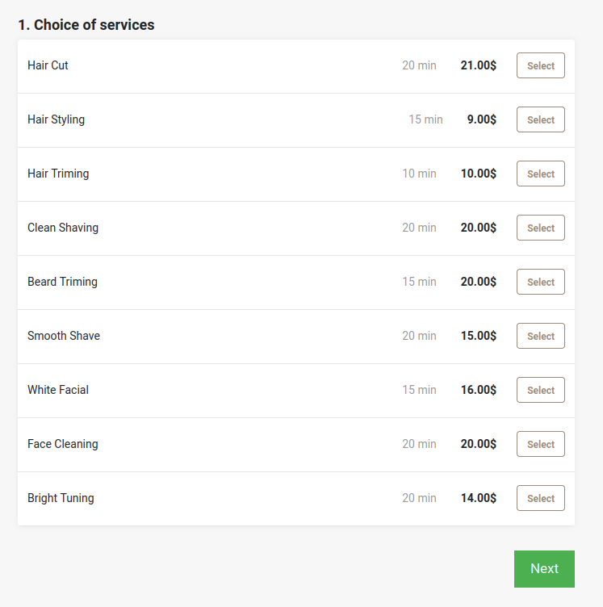
SERVICES SECTION

Slide 5
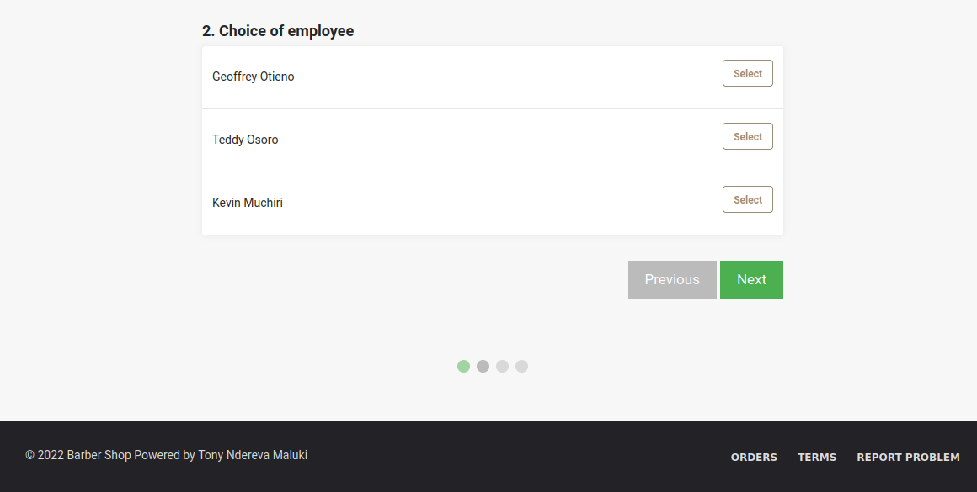
LIST OF BARBERS AVAILABLE TO CHOOSE

Slide 6
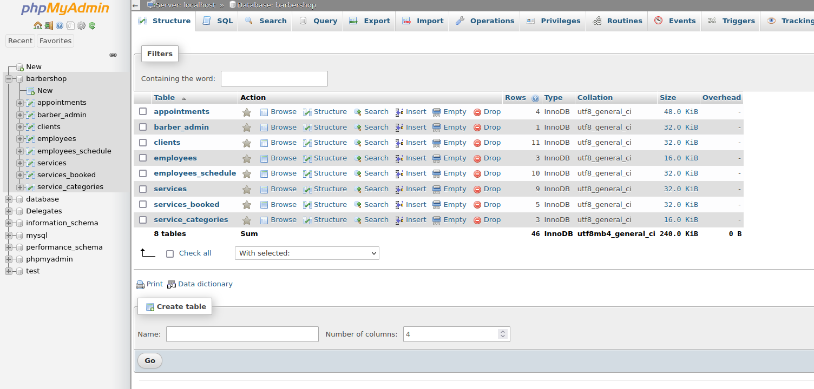
The Database System

